Slide 1
GHANA CALIBRATION
1km

Slide 2
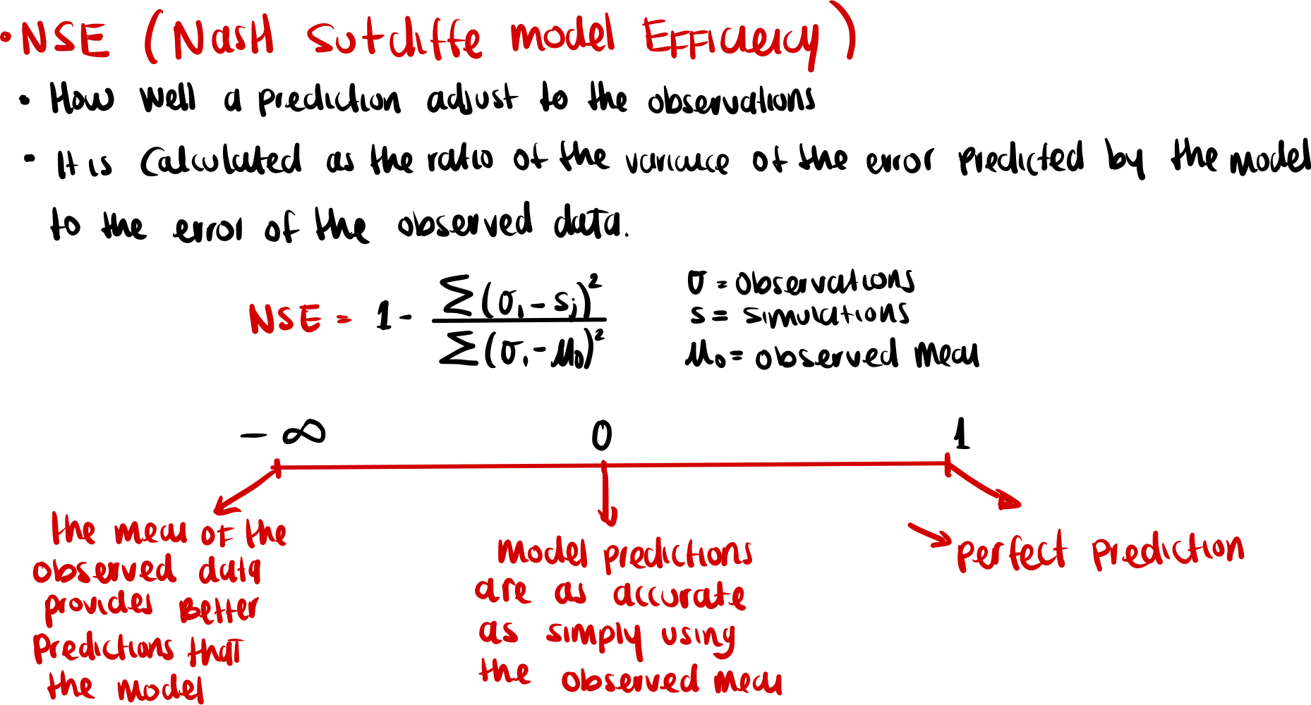
Notes:
Source trail

Slide 3
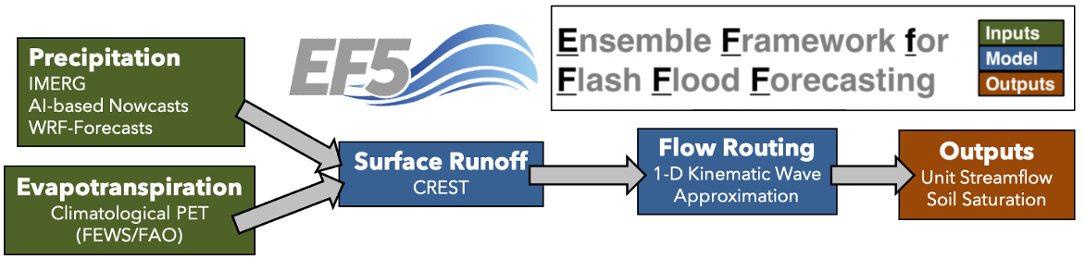
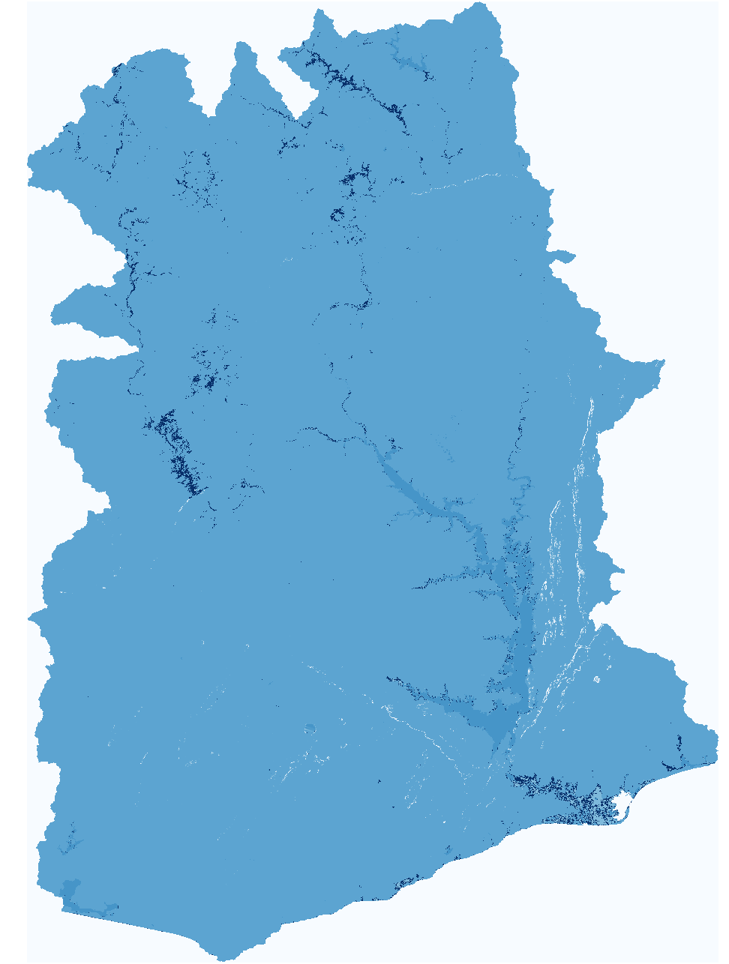
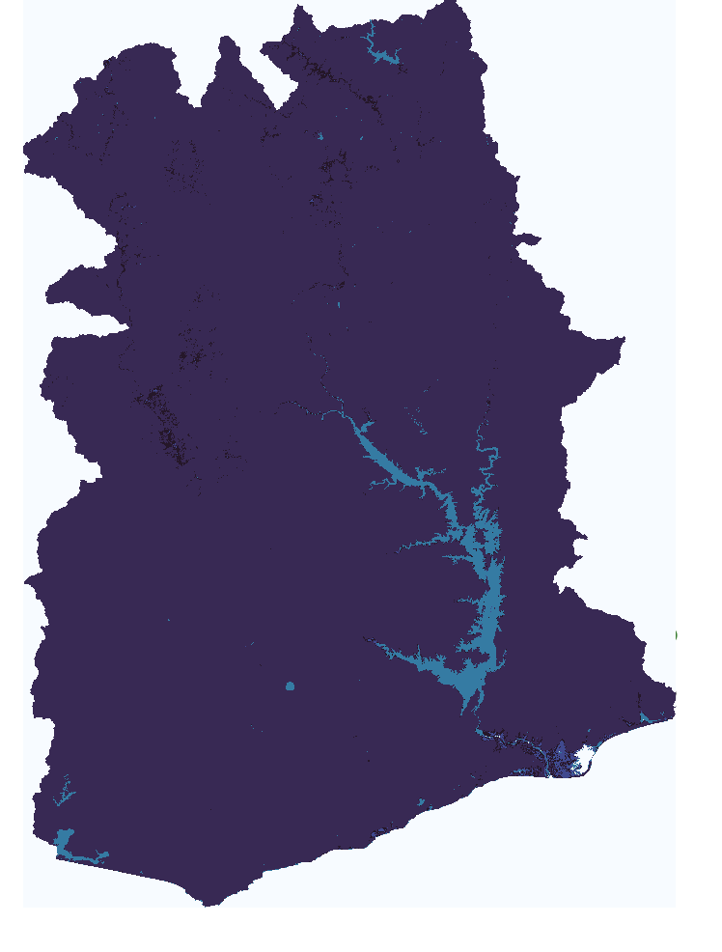
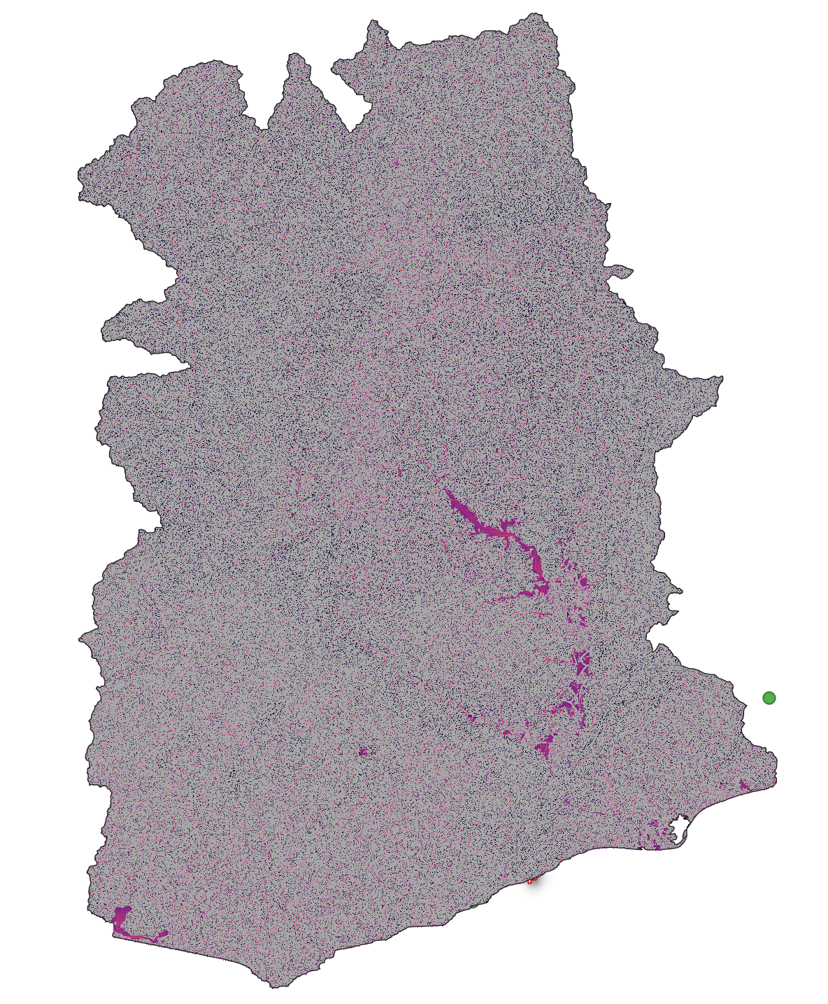
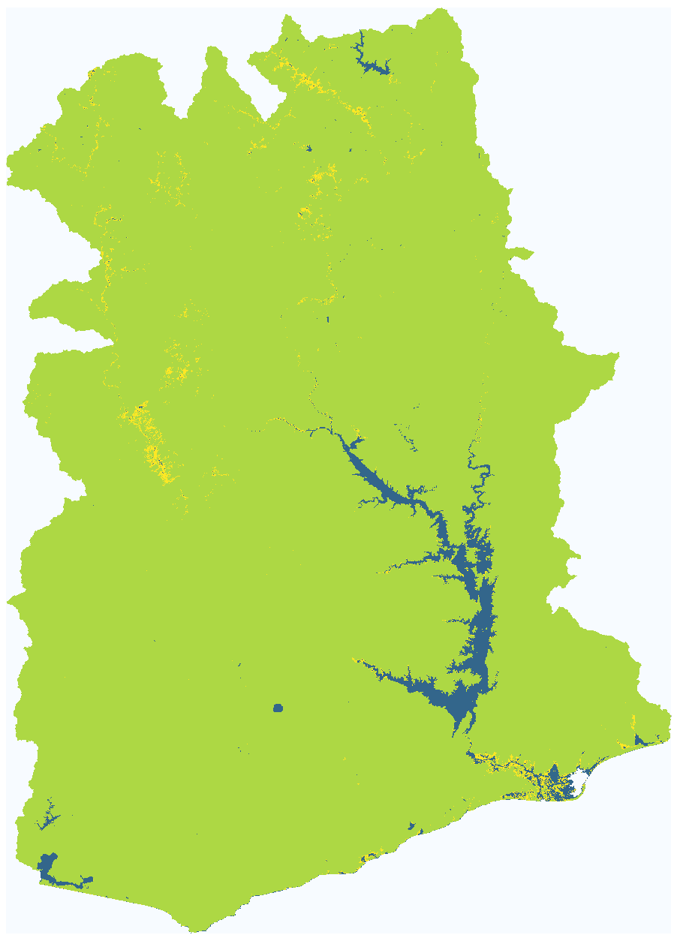
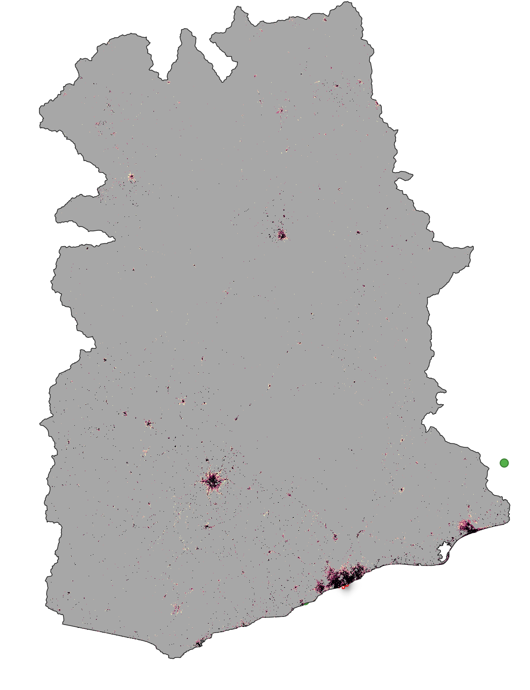
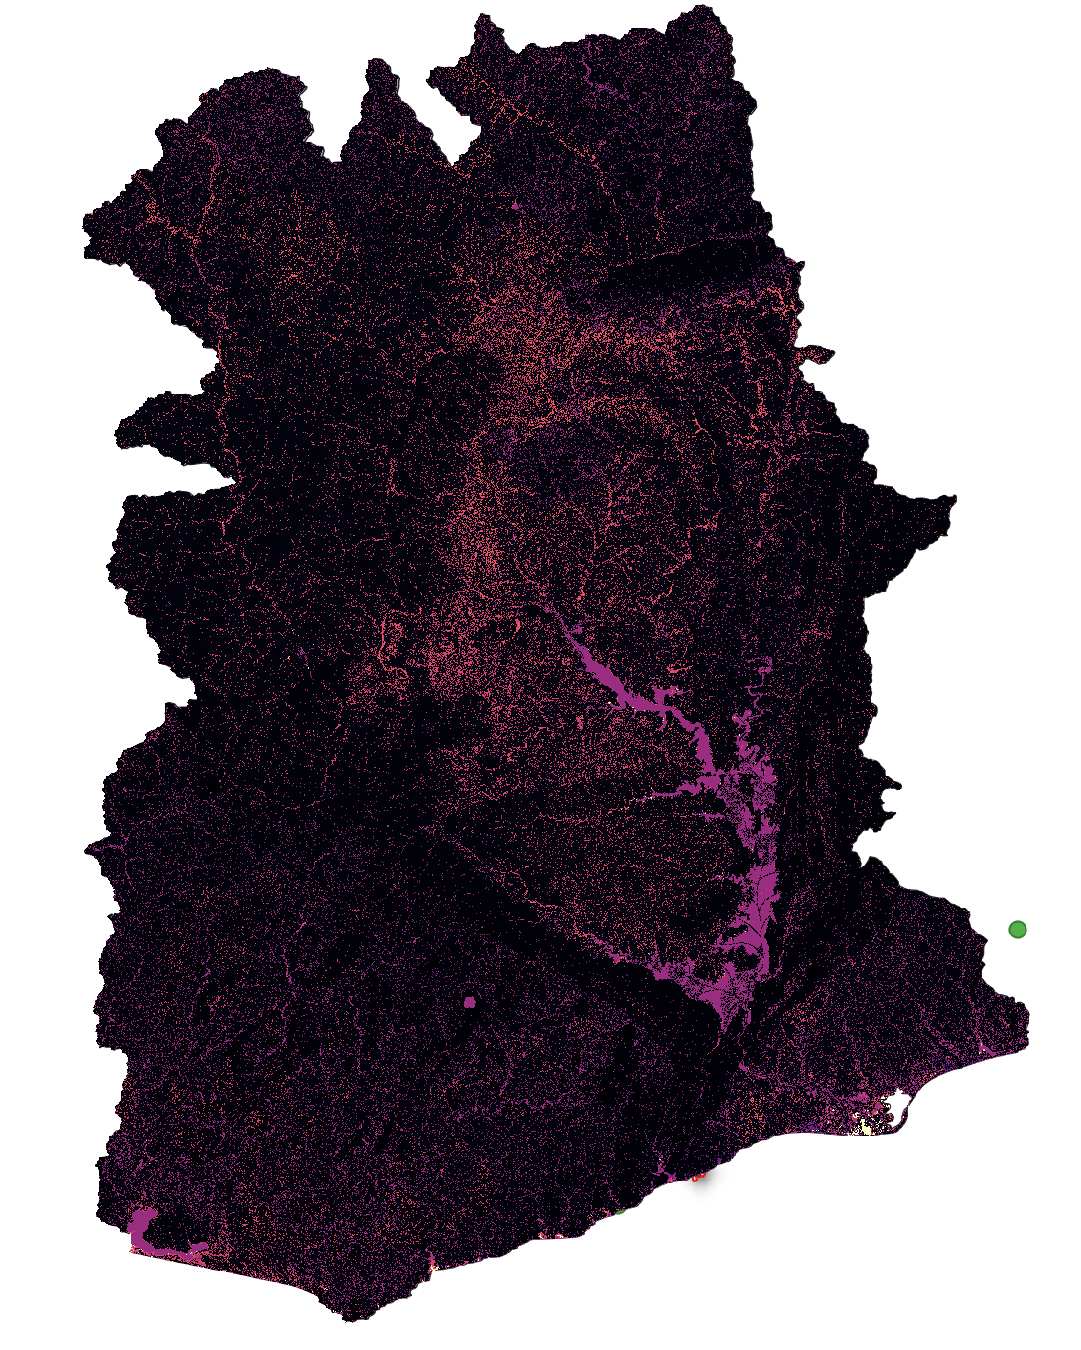
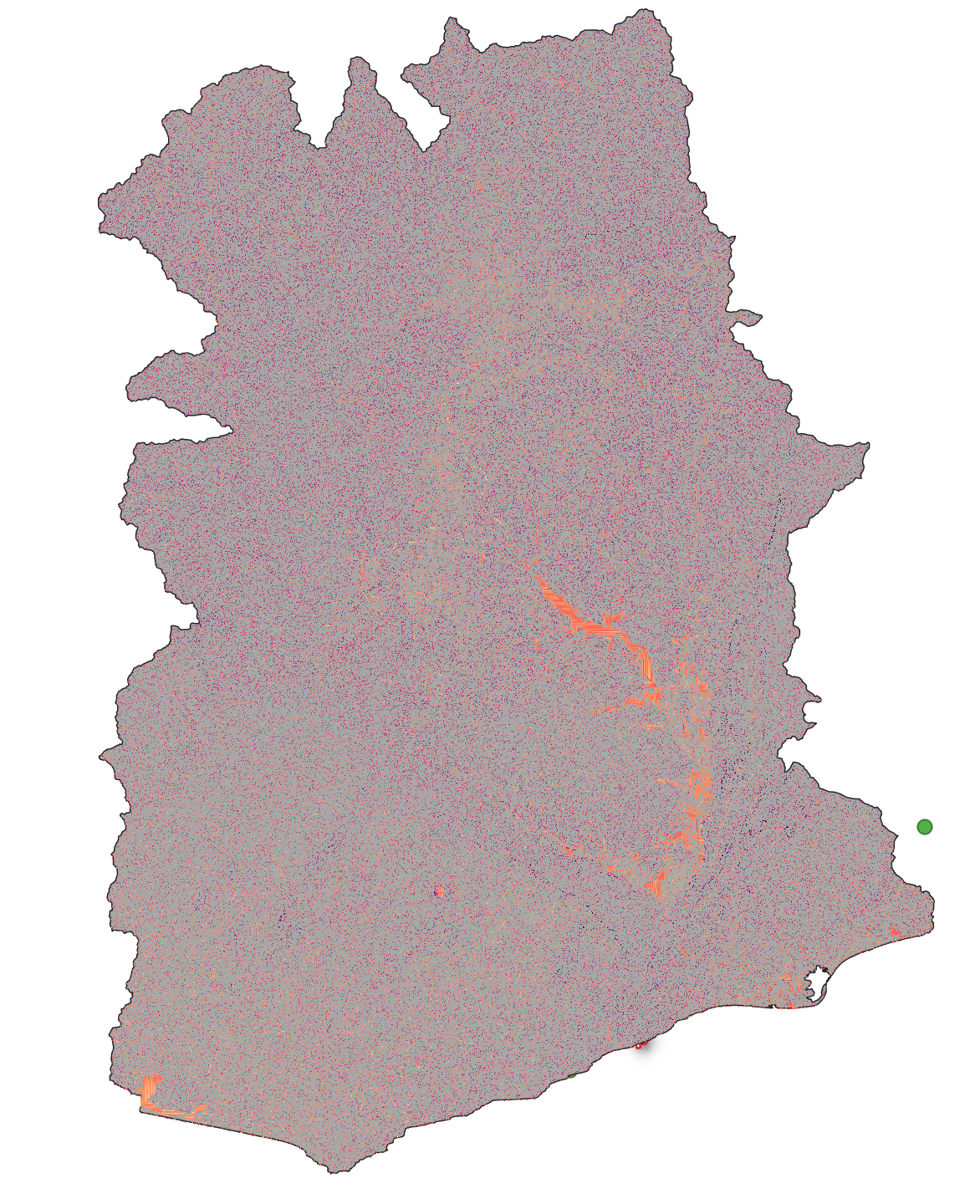
Ghana90m Baseline
wm
ksat
alpha
b
im
alpha0
beta

Slide 4
Manual pixel correction was performed for all stations (for both models 1 km and 90m).
Data analysis and cleaning was performed, obtaining the series with which we want to calibrate/validate both models.
Ghana 90m:
New impervious surface layer was processed (improving model performance).
Baseline for Ghana90m ready.

Slide 5
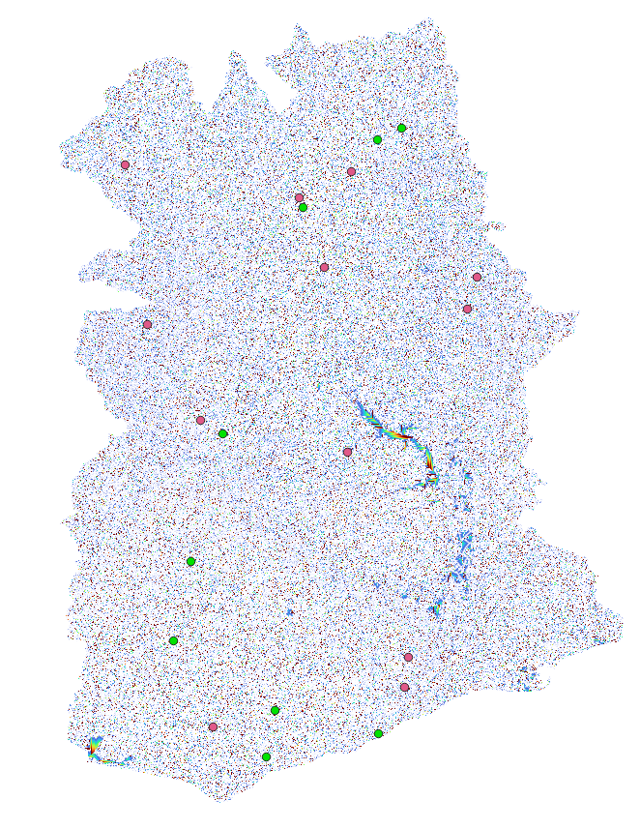
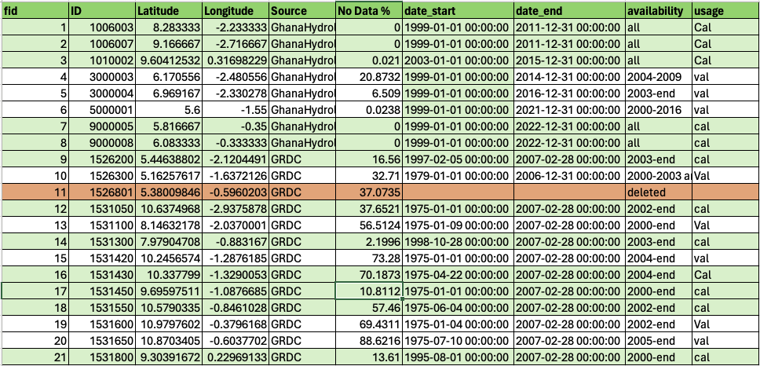
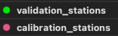
Gauge stations at 90m.
We currently have 21 stations.
We run with 20 stations:
12 for calibration, 8 for validation

Slide 6
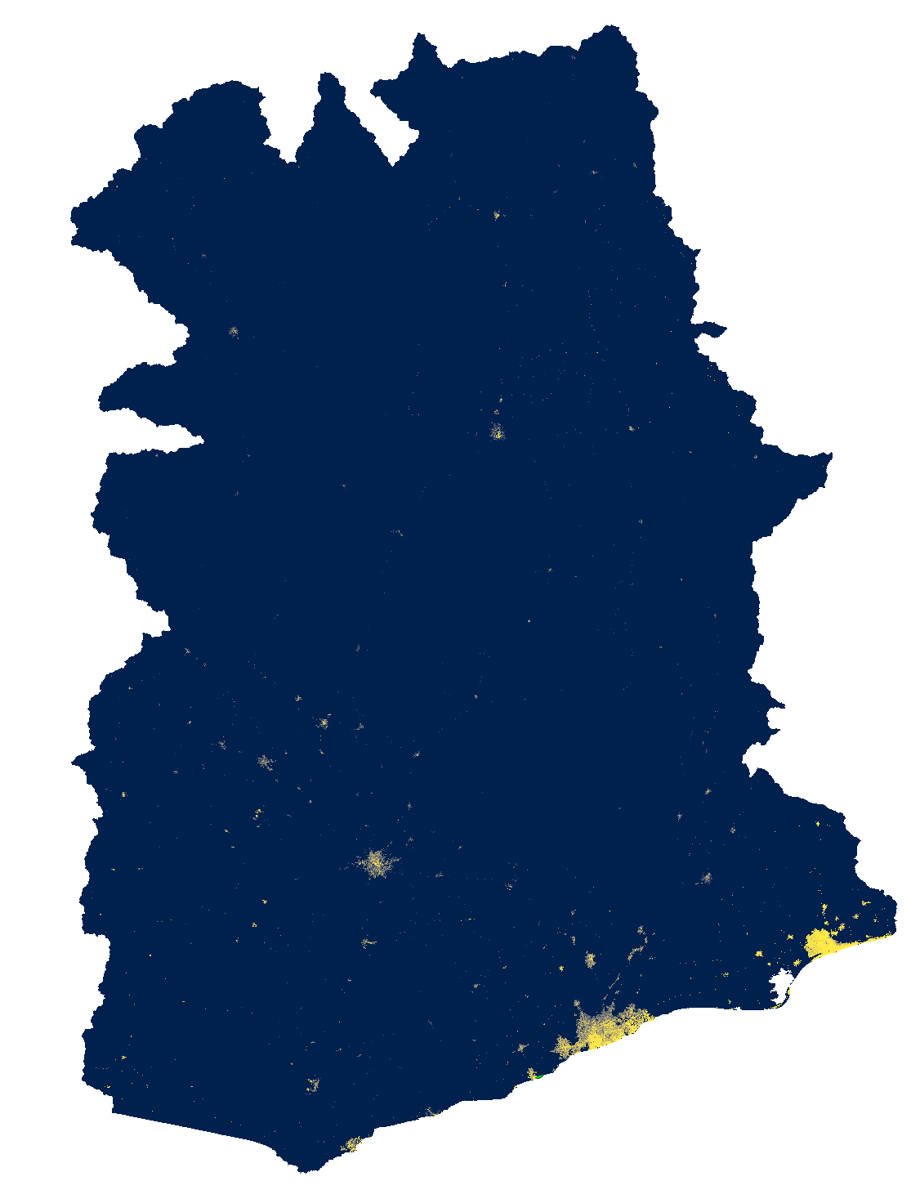
Global Man-made Impervious Surface (GMIS) Dataset From Landsat, v1 (2010)
Spatial resolution: 30m spatial resolution. The spatial extent covers the entire globe except Antarctica and some small islands. This dataset is the first global, 30m dataset of man-made impervious cover to be derived from the GLS data for 2010 and is a companion dataset to the Global Human Built-up And Settlement Extent (HBASE) dataset.
Data values: Percent imperviousness (0-100)
Limitations: The GMIS/HBASE datasets are derived directly from Landsat imagery from the Global Land Survey (GLS) 2010 dataset (Gutman et al. 2013). The quality of the GMIS/HBASE datasets is impacted by limitations of the selected GLS 2010 imagery and still contain residual cloud covered areas and areas where gaps caused by the Landsat 7 Scan Line Corrector (SLC) failure have not been successfully filled. The SLC gaps can cause visual features to appear in the data at different zoom levels. Areas where the gaps still persist or where cloud cover/cloud shadows were found have been coded as “NoData" (i.e. value = 255).
Processing: Data was processed by interpolation the NoData values.
Brown de Colstoun, E. C., C. Huang, P. Wang, J. C. Tilton, B. Tan, J. Phillips, S. Niemczura, P.-Y. Ling, and R. E. Wolfe. 2017. Global Man-made Impervious Surface (GMIS) Dataset From Landsat. Palisades, New York: NASA Socioeconomic Data and Applications Center (SEDAC).https://doi.org/10.7927/H4P55KKF.

Slide 7
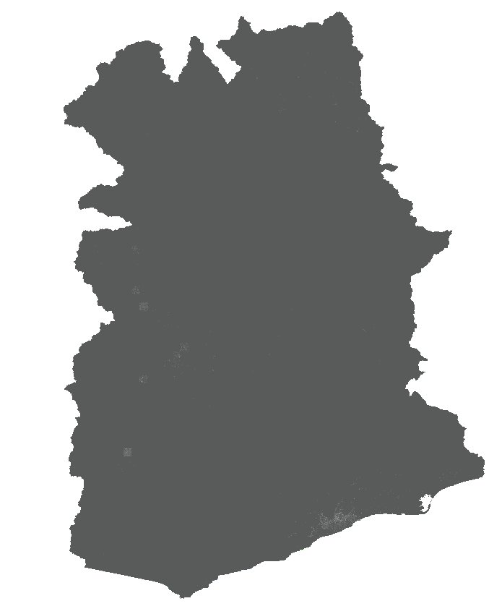
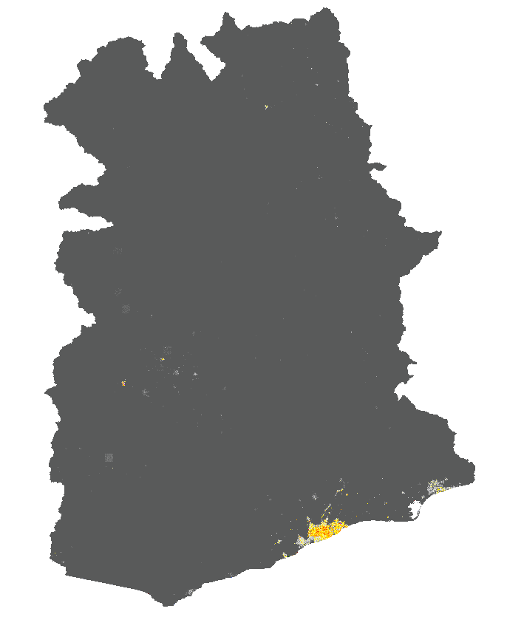
-No warmup
-New impervious surface layer
-No warmup
-Old impervious surface layer

Slide 8
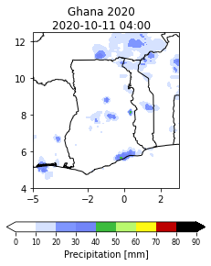
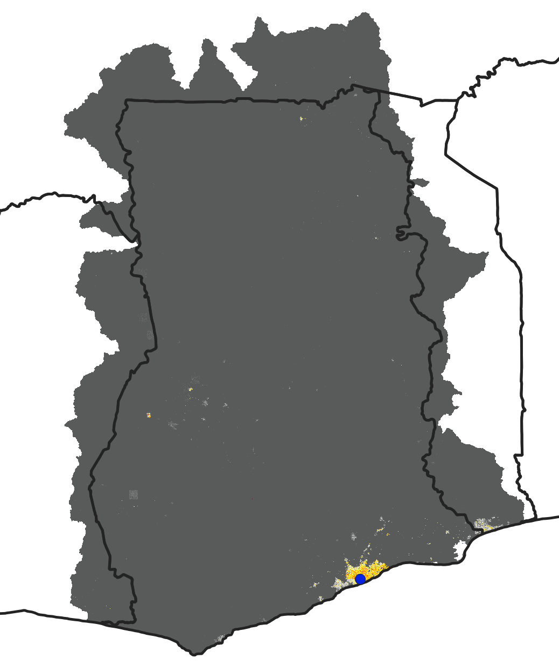
-No warmup
-Old impervious surface layer
-No warmup
-Old impervious surface layer

Slide 9
#!/bin/bash
#SBATCH --job-name=EF5_run # job name
#SBATCH --partition=SOE_main # partition (queue)
#SBATCH --mem=32000 # memory per node in MB
#SBATCH --output=bl3.out # file to collect standard output
#SBATCH --error=bl3.err # file to collect standard errors
/volume/NFS/en279/EF5/bin/ef5 control_gauges_ghana.txt

Slide 10
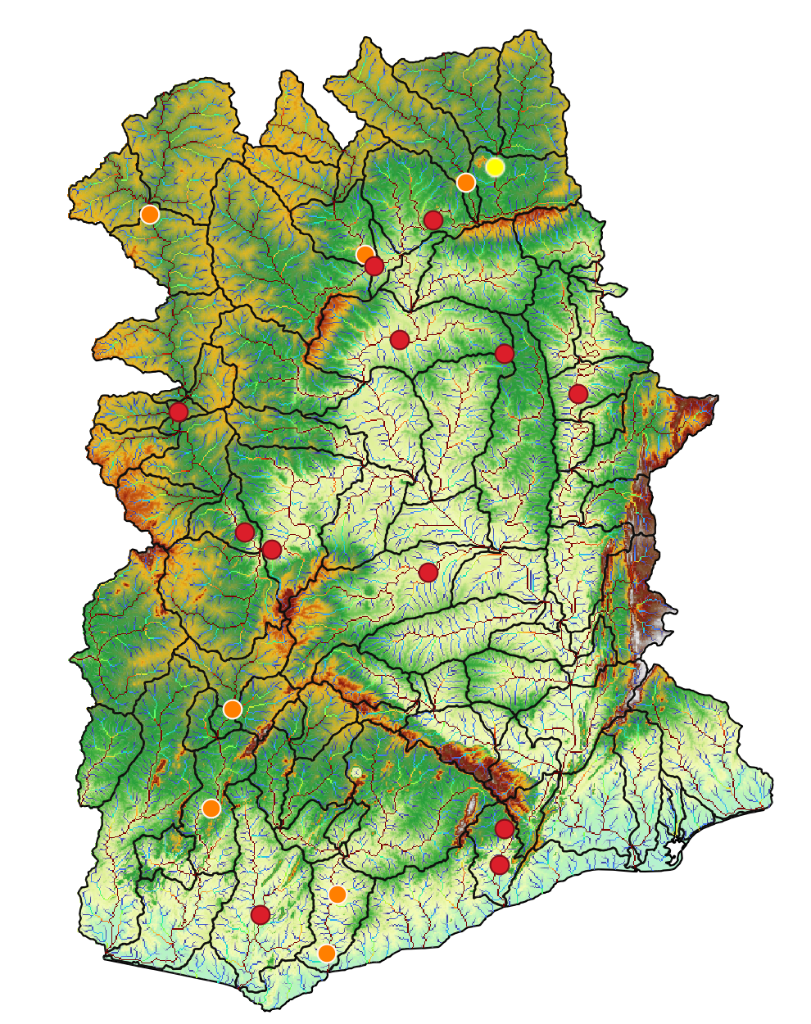
Station=1531600
Notes:
We have some prelimiry results for our ghana baseline. In most of the cases the model overestimate the discharge, however where the model subestimate the observations the NASH error is not so bad. For instance, this two stations..

Slide 11
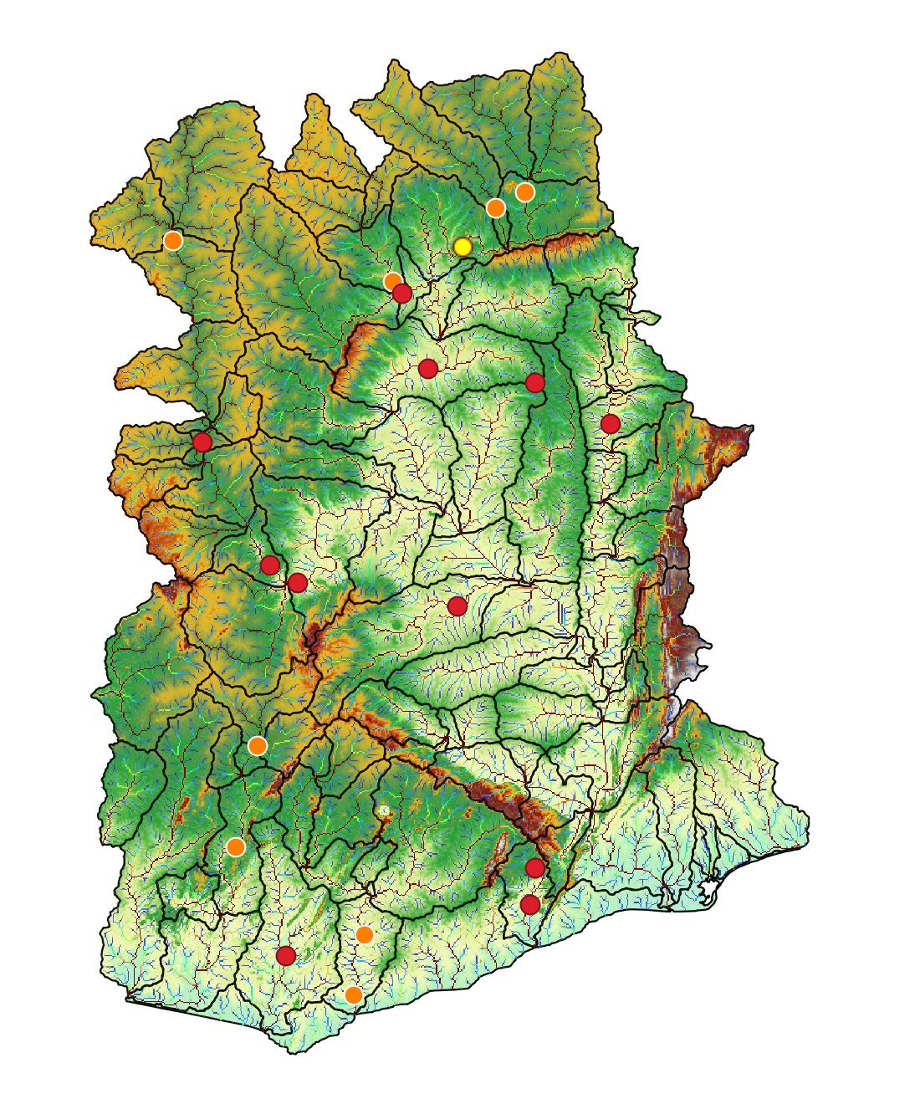
Station=1531550

Slide 12
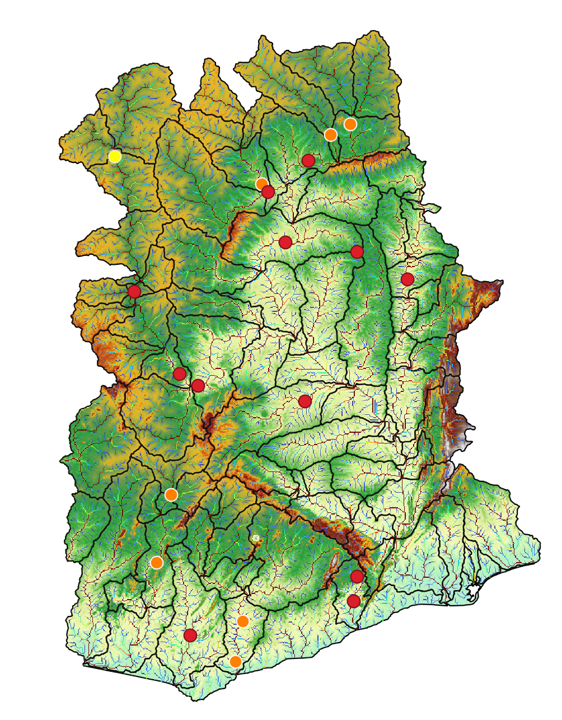
Station=1531050
Notes:
Here for example the model overestimate the observations, but with a negative nash error which is something we don’t want to

Slide 13
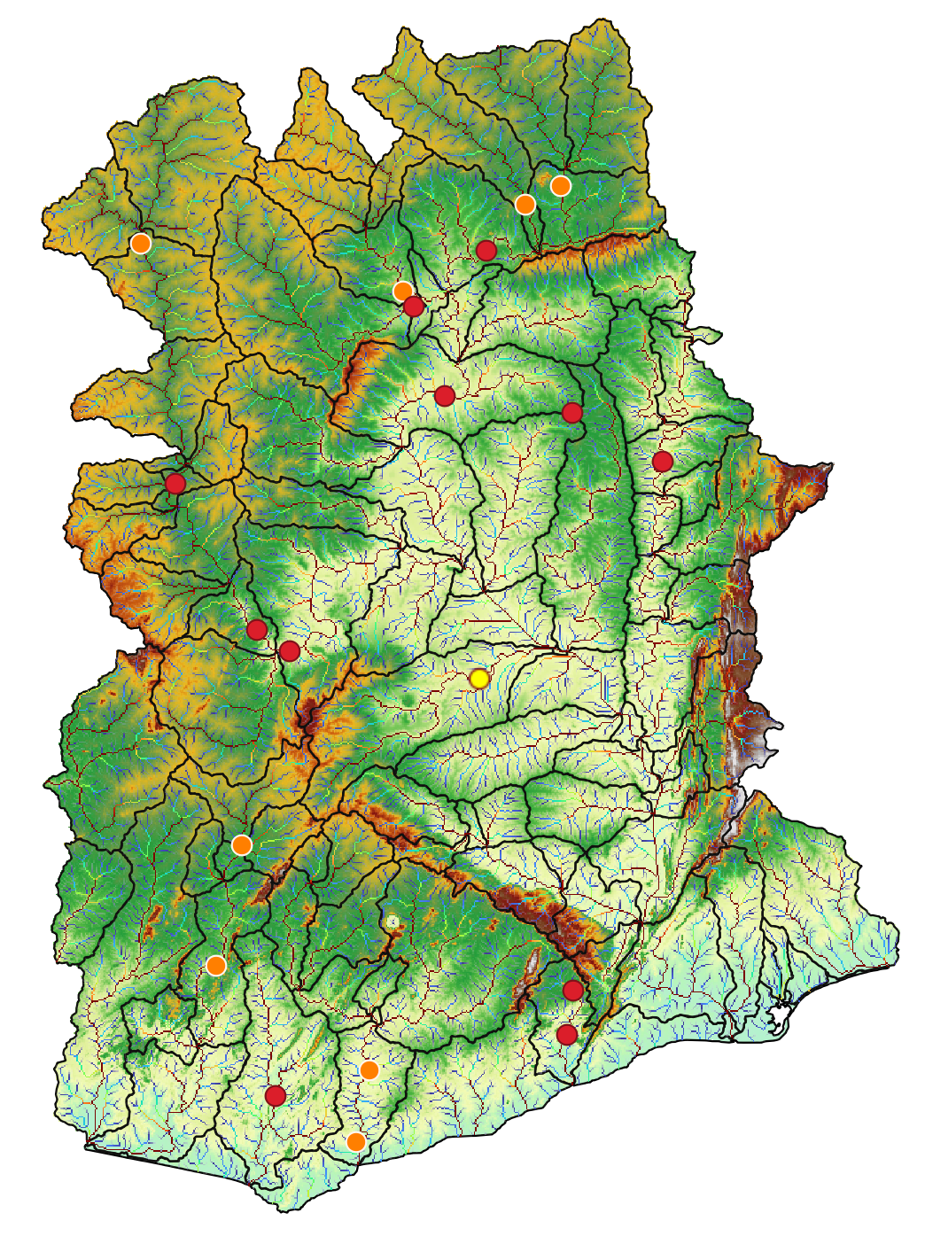
Station=1526300

Slide 14
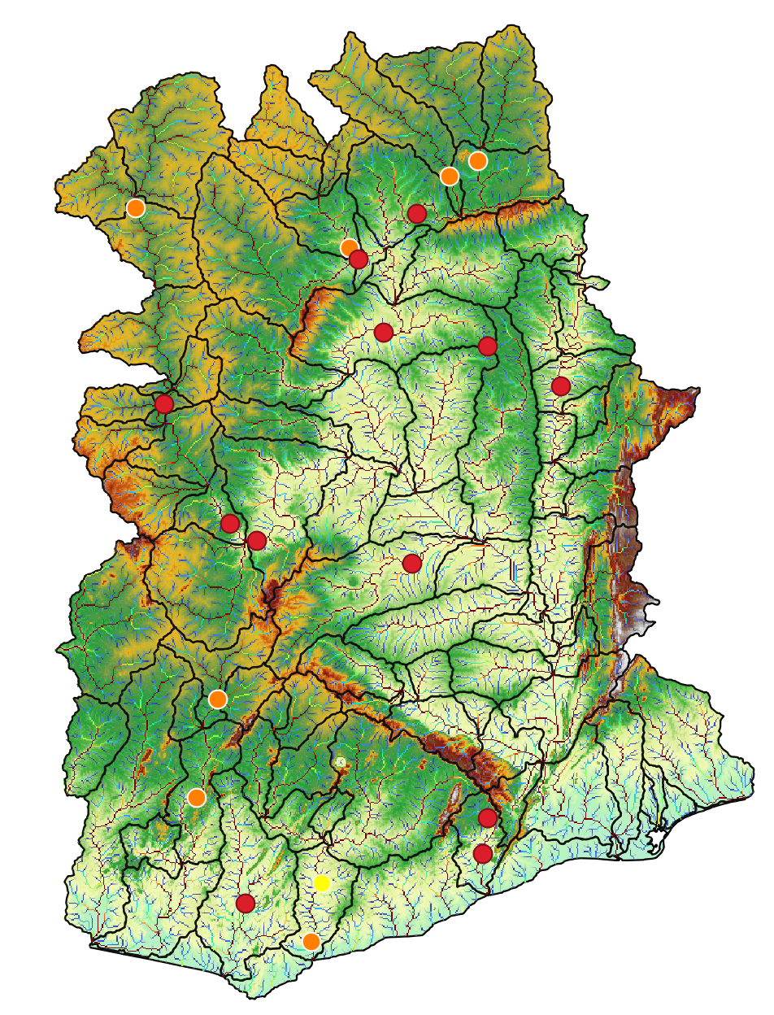
Station=5000001
Notes:
We realize that for some stations we don’t have data from the model, so we need to correct the location of the gauge.
So, this week we are going to correct that locations and run again the model to see if improves

Slide 15
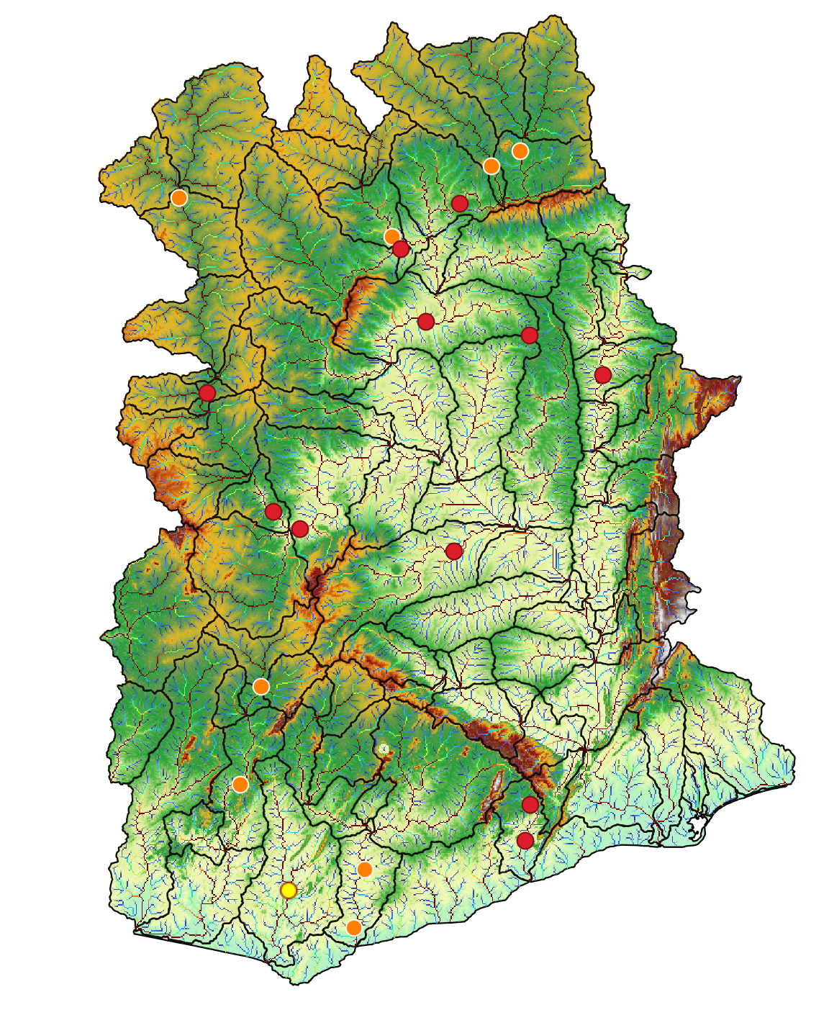
Station=1526200

Slide 16
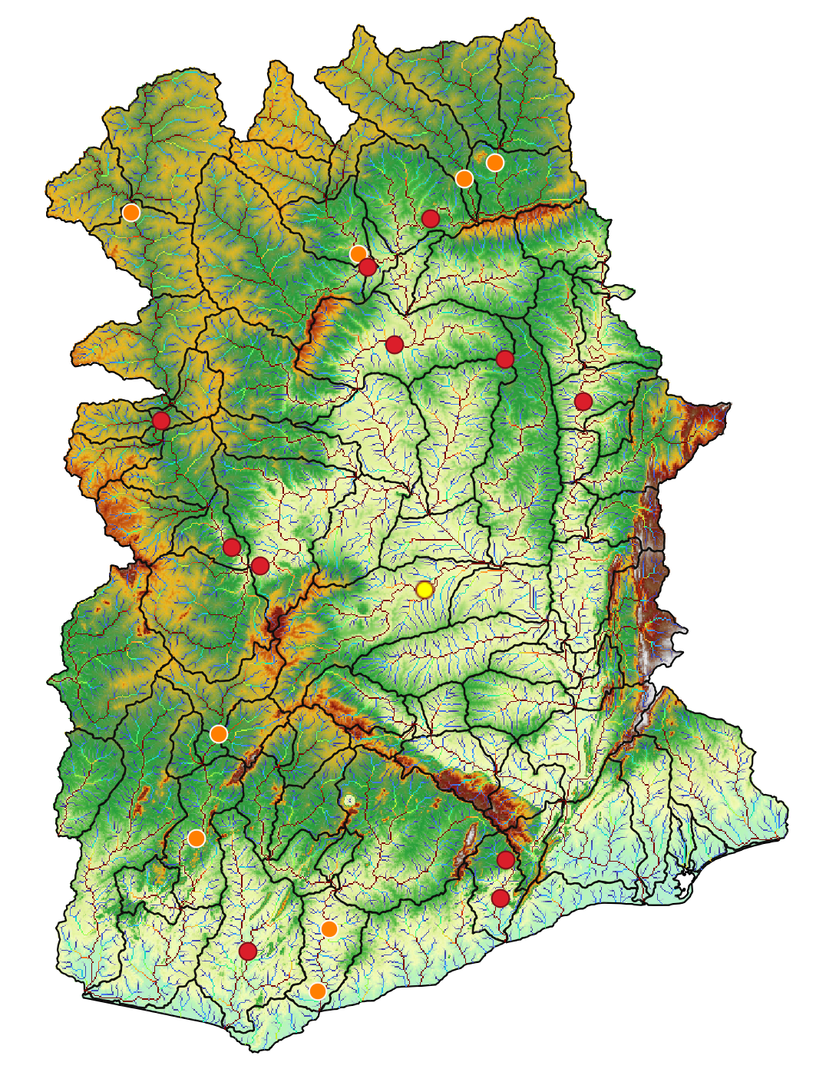
Station=1526801

Slide 17
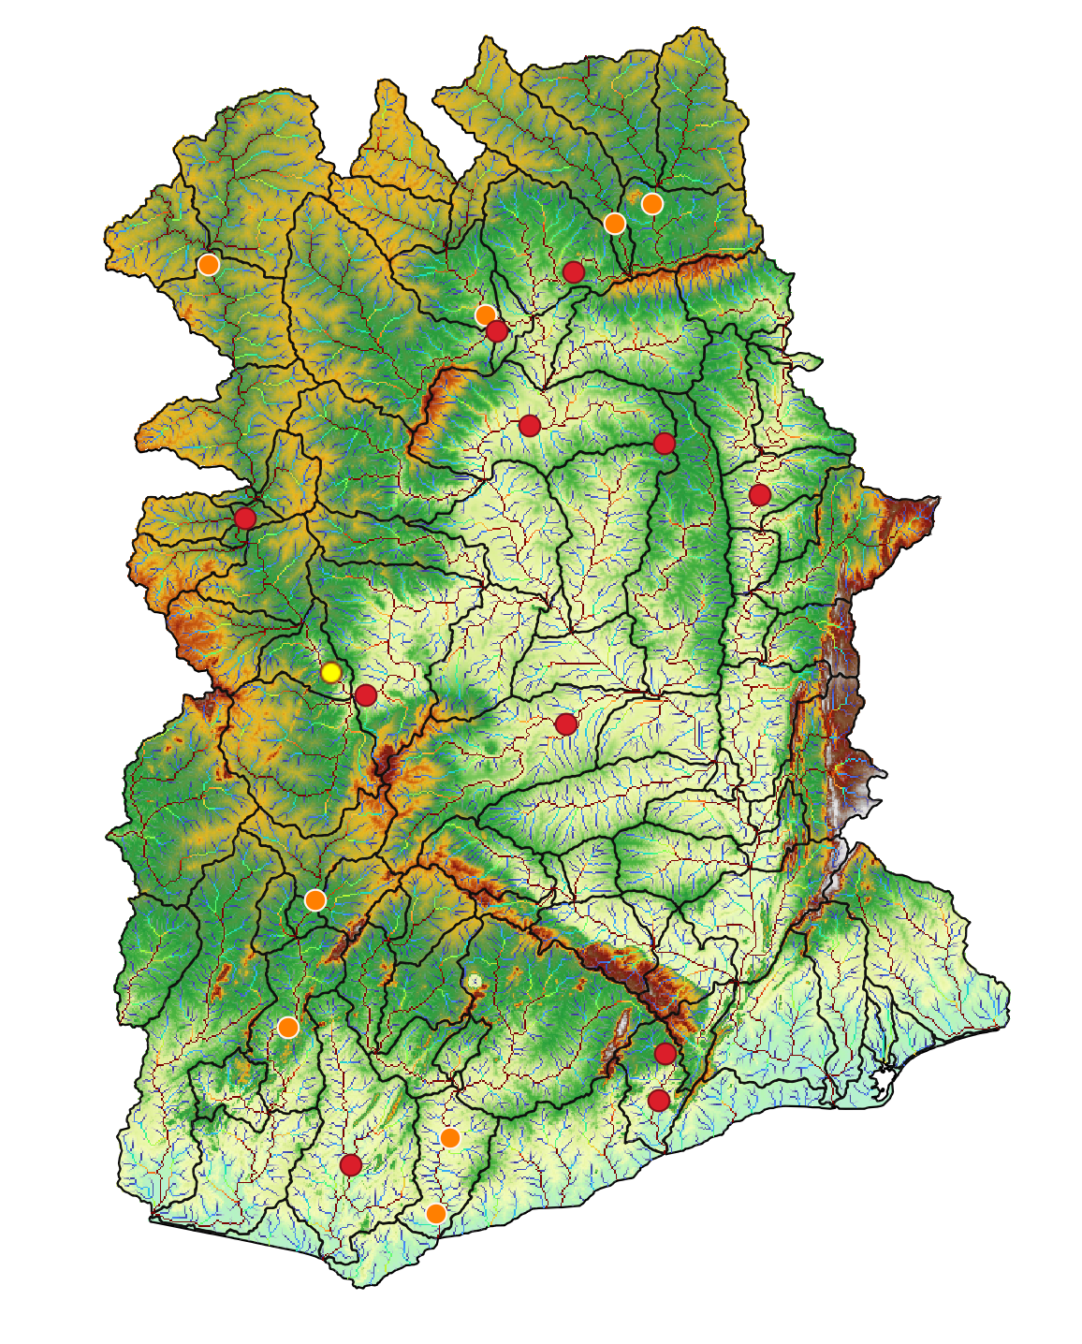
Station=1006003

Slide 18
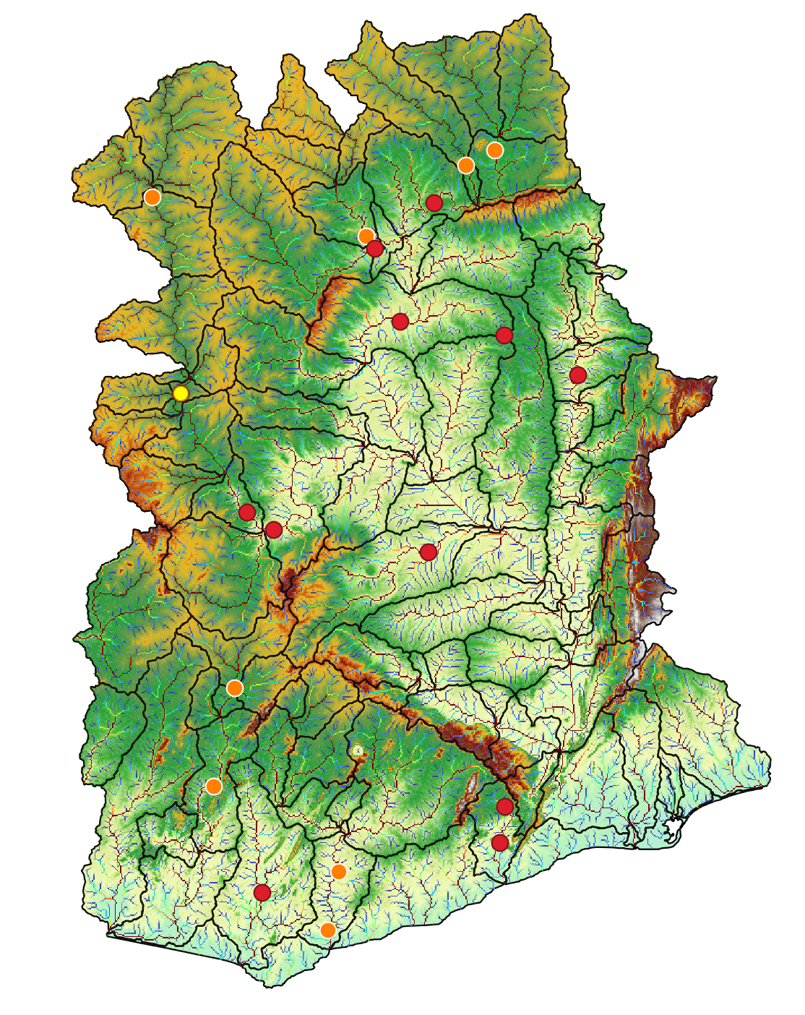
Station=1006007

Slide 19
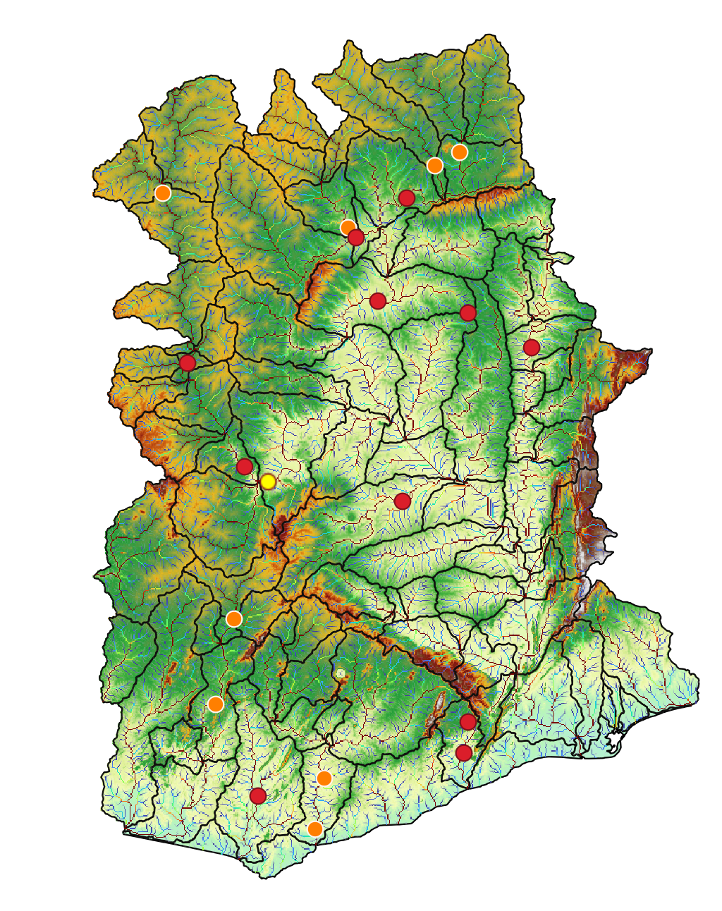
Station=1531100

Slide 20
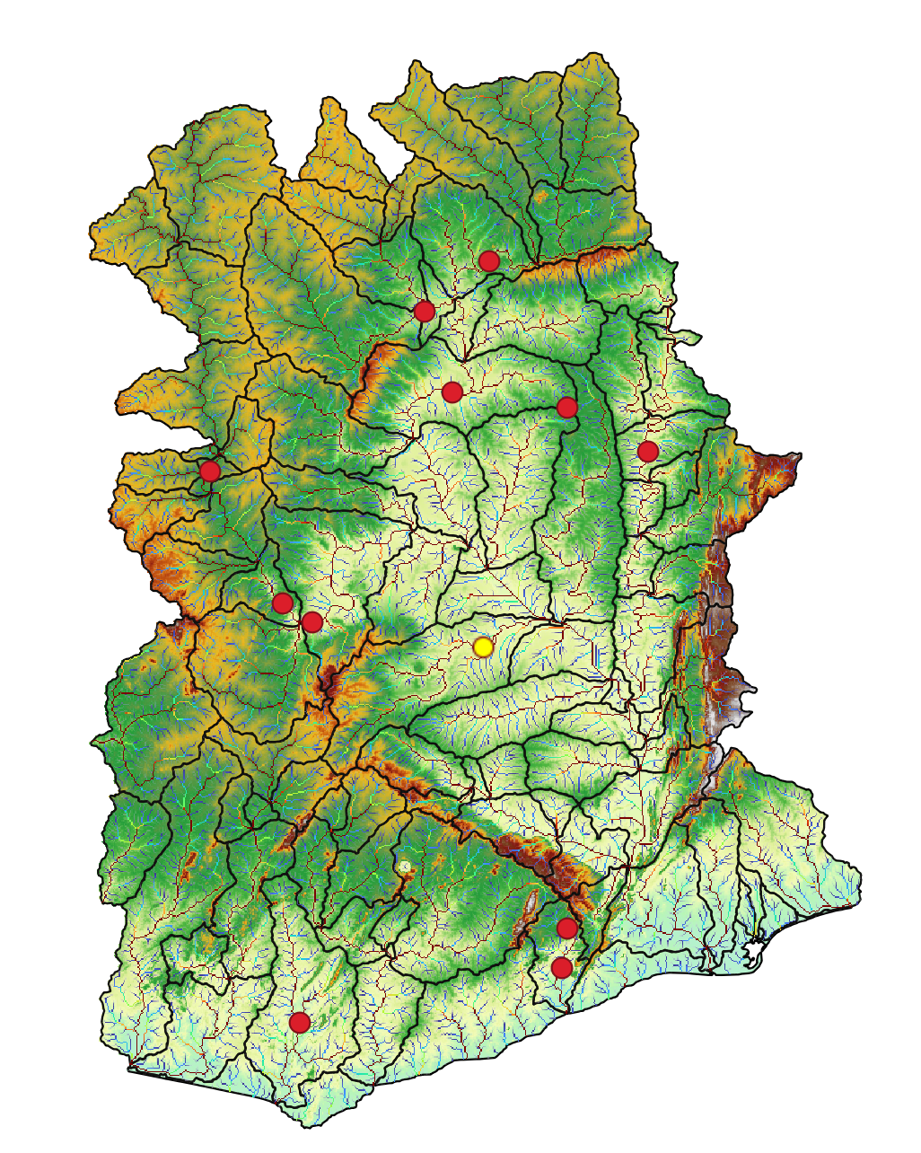
Station=1531300

Slide 21
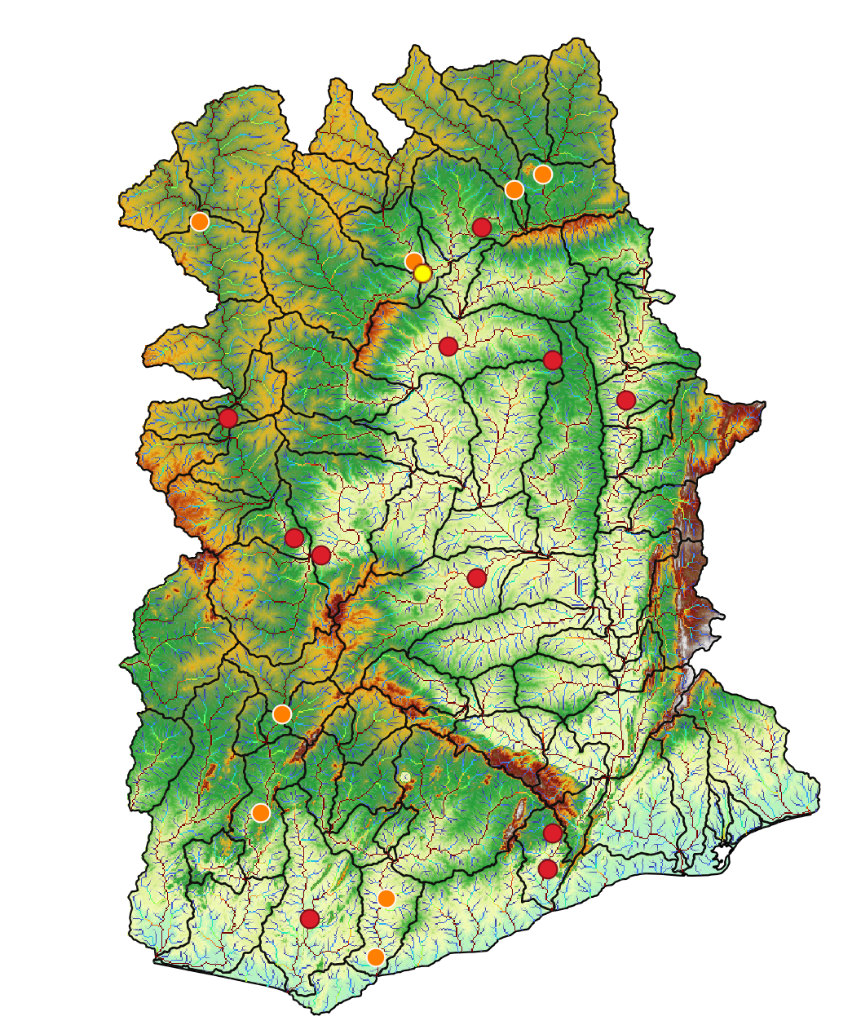
Station=1531420

Slide 22
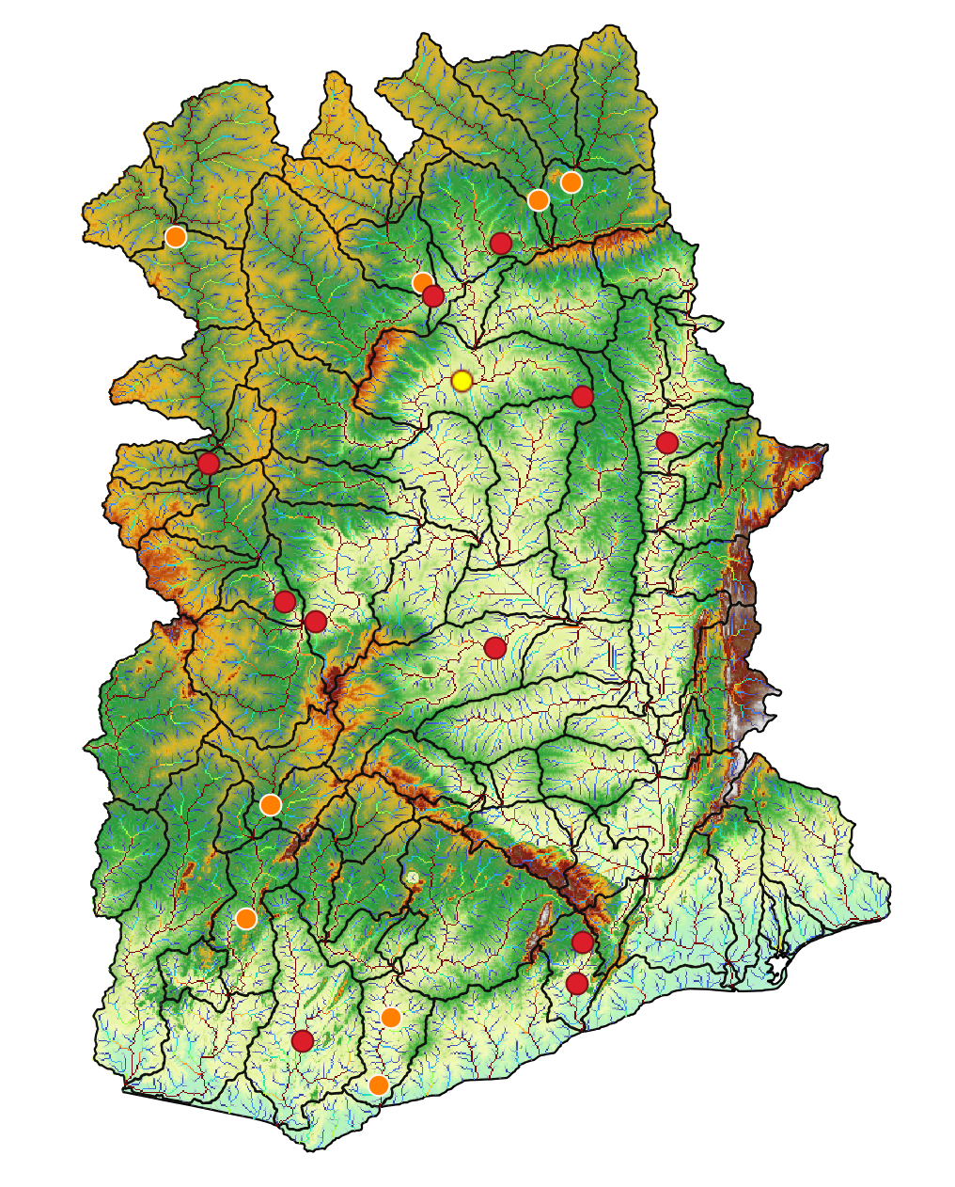
Station=1531450

Slide 23

Station=1531650

Slide 24
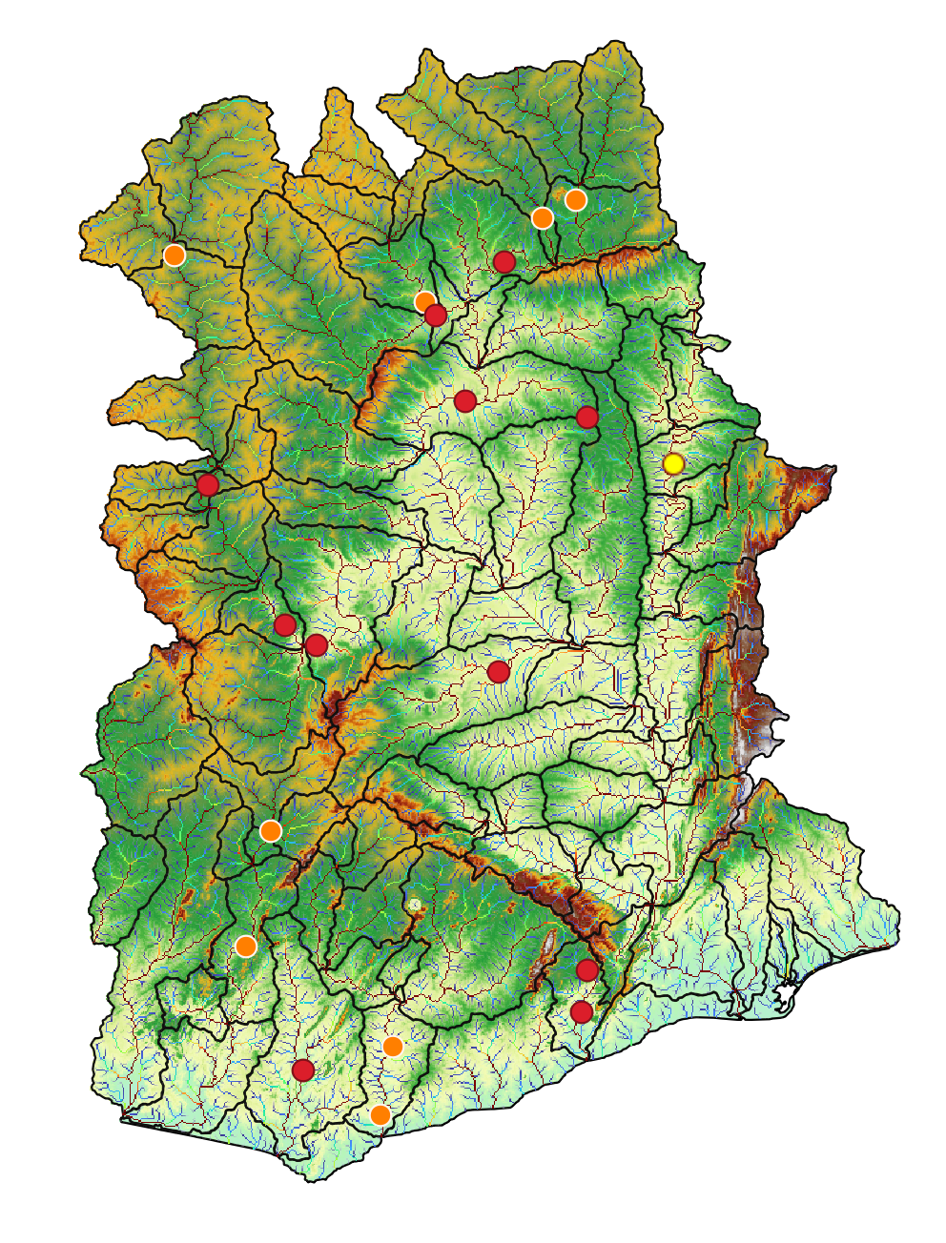
Station=1531800

Slide 25

Station=3000003

Slide 26
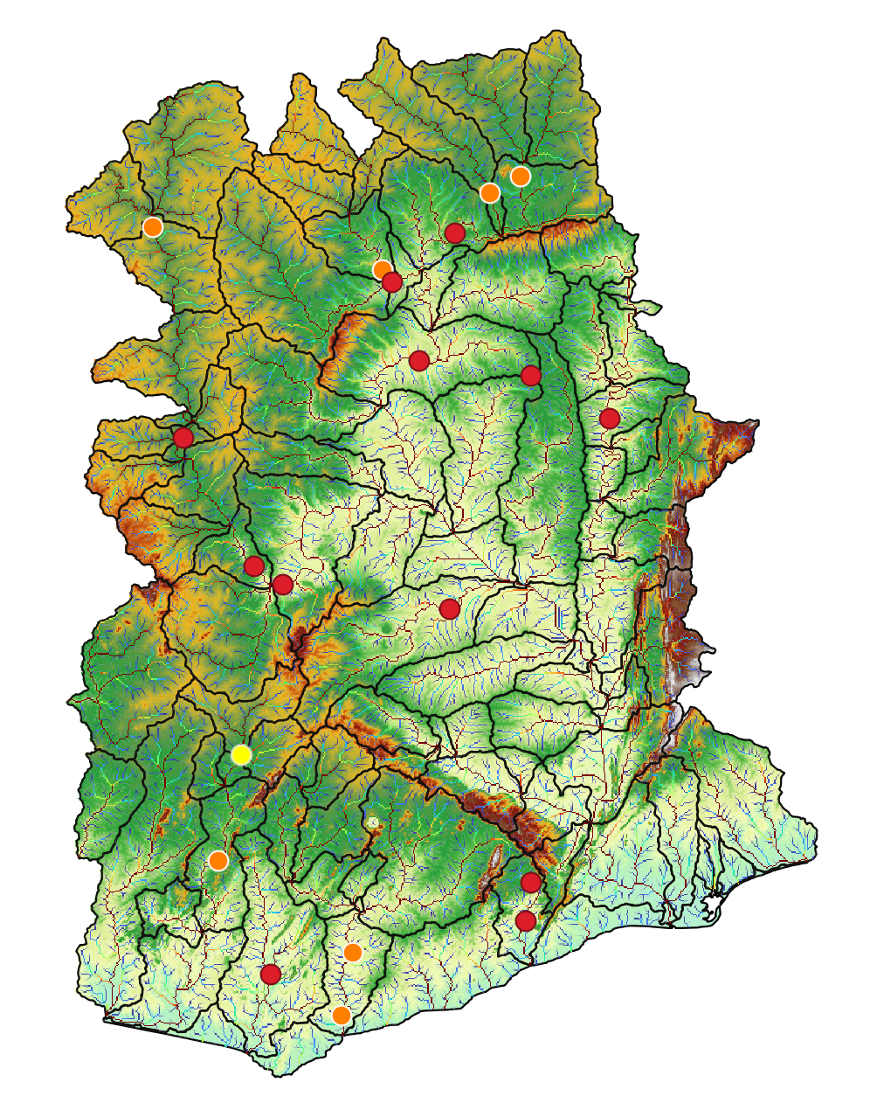
Station=3000004

Slide 27
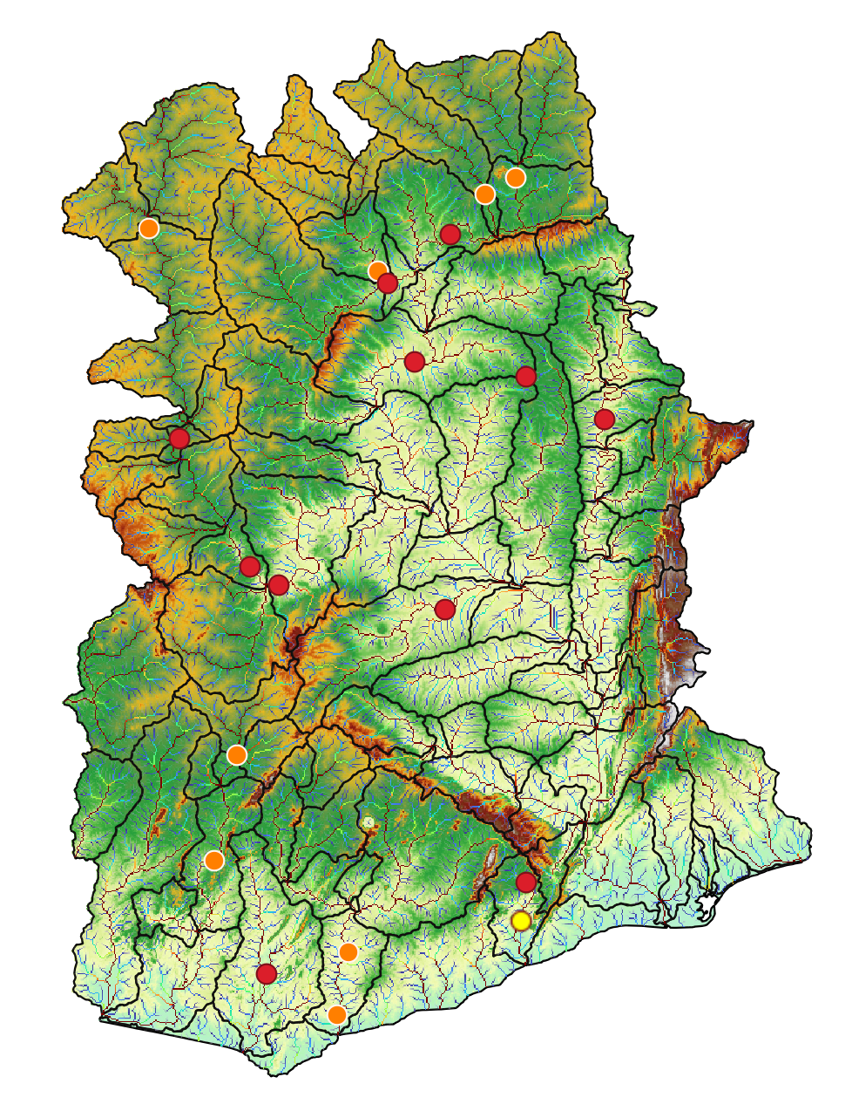
Station=9000005

Slide 28
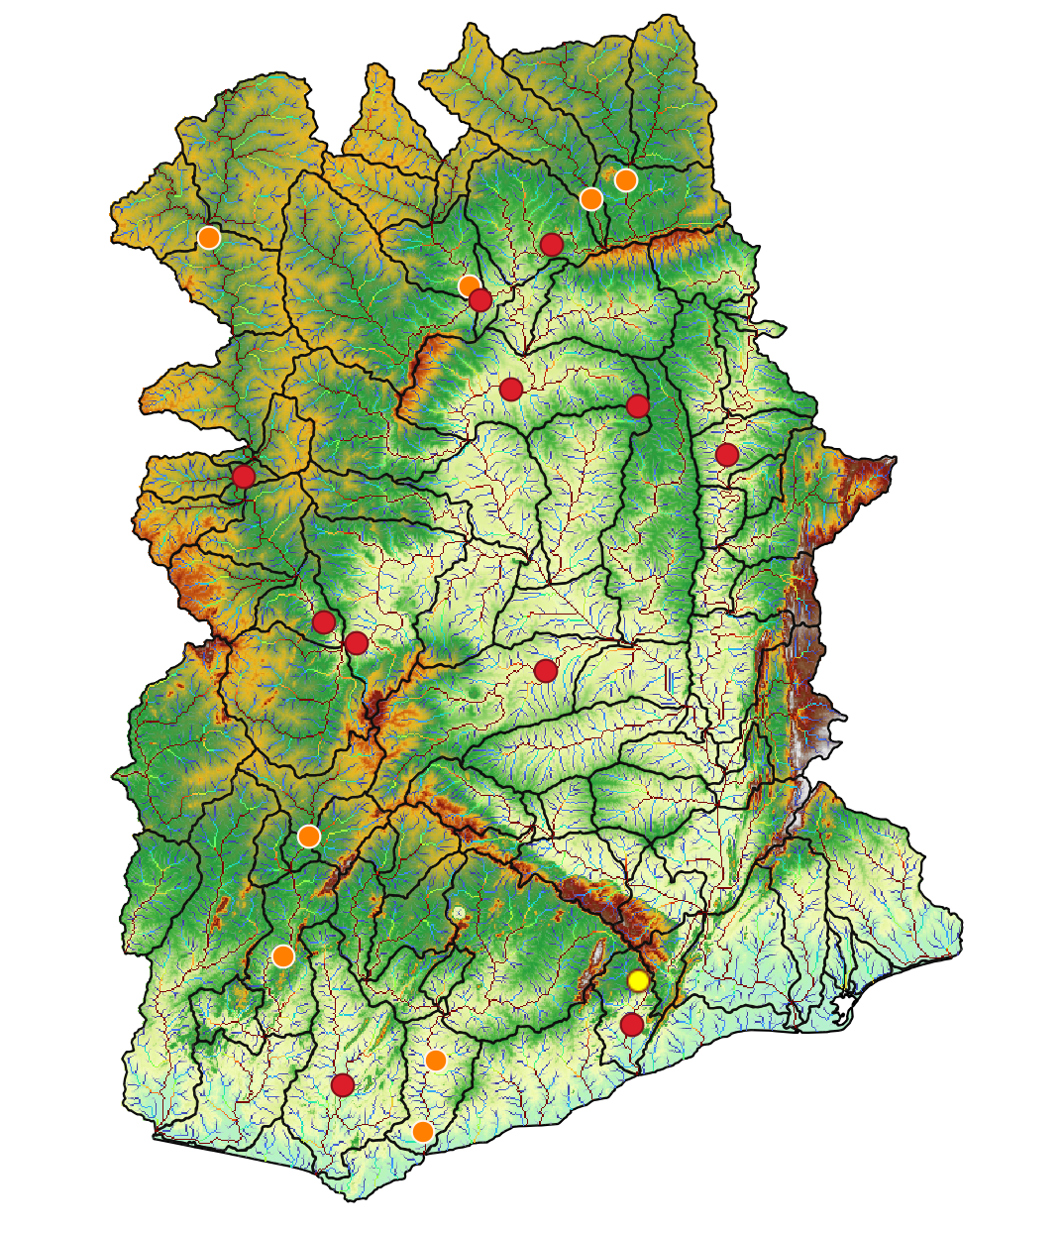
Station=9000008

